Slide 1
OPERATING SYSTEM
Lecturer: Suman Thapaliya
Intermediate: Singapore (2009)
Bachelor Of Science in Computing: (UK)LMU (2013)
Master’s Of Science In IT:(UK) LMU (2015)
Doctorate In Philosophy: Lincoln University (Running)

Slide 2
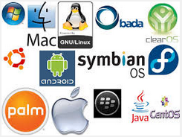
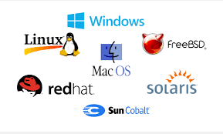
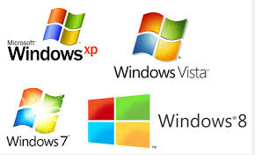
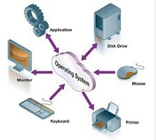
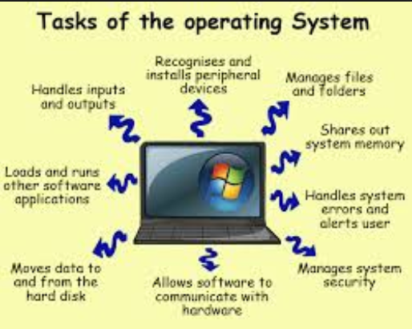

Slide 3
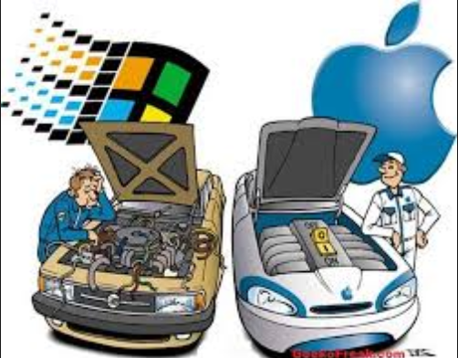
Just For Fun ……………. ☺

Slide 4
What is OS ?
Operating systems perform basic tasks, such as recognizing input from the keyboard, sending output to the display screen, keeping track of files and directories on the disk, and controlling peripheral devices such as disk drives and printers.
An operating system (also called an OS) is a piece of software that is needed to run the programs on a computer. The programs that run on an operating system talk to the hardware.

Slide 5
The operating system is the most important program that runs on a computer.
Every general-purpose computer must have an operating system to run other programs. Operating systems perform basic tasks, such as recognizing input from the keyboard, sending output to the display screen, keeping track of files and directories on the disk, and controlling peripheral devices such as disk drives and printers.

Slide 6
Timeline of OS
This Slide presents a timeline of events in the history of computer operating systems from 1951 to the current day.
1950s
1960s
1970s
1980s
1990s
2000s
2010s
Rest More details: http://en.wikipedia.org/wiki/Timeline_of_operating_systems

Slide 7
DOS-11 V09-20C (Last stable release, June 1974)
1985: Windows 1.0
1987: Windows 2.0
1990: Windows 3.0
Series of Windows start’s here …… ☺
2001 – 10: Windows XP, Windows XP 64 – bit Edition.
2002 – 09: Windows XP service pack 1
2003 – 04: Windows XP 64 – bit Edition 2003
2003 – 04: Windows server 2003
2004 – 08: Windows XP service pack 2

Slide 8
2005 : Windows server 2003 service pack 1, XP Professional X64 Edition.
2006 – 11: Windows Vista
2007 : Windows Home server
2008: Service pack of Vista and server
2009: Windows 7, Windows server 2008
2011: Windows 7 service pack 1
2012: Windows 8
2013: Windows 8.1, Windows server 2012
2015: ………. Any Guesses ☺

Slide 9
History of OS
The first true digital computer was designed by the English mathematician Charles Babbage (1792 – 1871). Although Babbage spend most of his life and fortune trying to build his “analytical engine”, he never got it working properly because it was purely mechanical and the technology of his date could not produce the required wheels gears and other high level precision that he needed. Need less to say, the analytical engine did not have an OS.
As an interesting historical aside, Babbage realized that he would need software for his analytical engine, so he hired a young woman named Ada Lovelace, who was the daughter of the famed British Poet Lord Byron, as the world’s first programmer. The programming language Ada is named after her.

Slide 10
Introduction to OS
Computer operating systems (OSes) provide a set of functions needed and used by most application programs on a computer, and the linkages needed to control and synchronize computer hardware. On the first computers, with no operating system, every program needed the full hardware specification to run correctly and perform standard tasks, and its own drivers for peripheral devices like printers and punched paper card readers. The growing complexity of hardware and application programs eventually made operating systems a necessity.

Slide 11
Background
The earliest computers were mainframes that lacked any form of operating system. Each user had sole use of the machine for a scheduled period of time and would arrive at the computer with program and data, often on punched paper cards and magnetic or paper tape. The program would be loaded into the machine, and the machine would be set to work until the program completed or crashed. Programs could generally be debugged via a control panel using toggle switches and panel lights.

Slide 12
Starting of OS
The first operating system used for real work was GM-NAA I/O, produced in 1956 by General Motors' Research division for its IBM 704. Most other early operating systems for IBM mainframes were also produced by customers.
Early operating systems were very diverse, with each vendor or customer producing one or more operating systems specific to their particular mainframe computer. Every operating system, even from the same vendor, could have radically different models of commands, operating procedures, and such facilities as debugging tools. Typically, each time the manufacturer brought out a new machine, there would be a new operating system, and most applications would have to be manually adjusted, recompiled, and retested.

Slide 13
History of OS
This is a list of operating systems. Computer operating systems can be categorized by technology, ownership, licensing, working state, usage, and by many other characteristics. In practice, many of these groupings may overlap. Criteria for inclusion is notability, as shown either through an existing Wikipedia article or citation to a reliable source.
For more detail:
1.http://en.wikipedia.org/wiki/List_of_operating_systems
2.http://www.personal.kent.edu/~rmuhamma/OpSystems/Myos/osHistory.htm

Slide 14
History Of Operating System
The First generation of computer
The Second generation of computer
The Third generation of computer
The Fourth generation of computer

Slide 15
First Generation (1940-1956) Vacuum Tubes
The first computers used vacuum tubes for circuitry and magnetic drums for memory, and were often enormous, taking up entire rooms. They were very expensive to operate and in addition to using a great deal of electricity, generated a lot of heat, which was often the cause of malfunctions.
First generation computers relied on machine language, the lowest-level programming language understood by computers, to perform operations, and they could only solve one problem at a time. Input was based on punched cards and paper tape, and output was displayed on printouts.
The UNIVAC and ENIAC computers are examples of first-generation computing devices. The UNIVAC was the first commercial computer delivered to a business client, the U.S. Census Bureau in 1951.

Slide 16
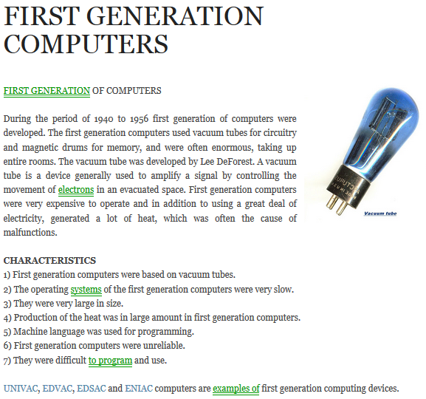

Slide 17
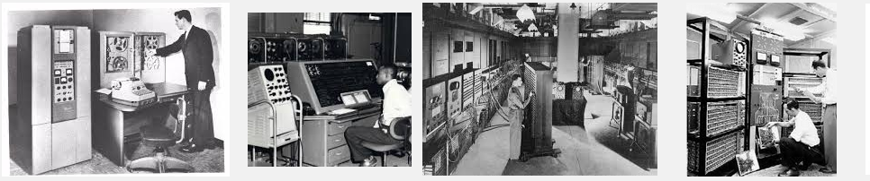

Slide 18
Second Generation (1956-1963) Transistors
Transistors replaced vacuum tubes and ushered in the second generation of computers. The transistor was invented in 1947 but did not see widespread use in computers until the late 1950s. The transistor was far superior to the vacuum tube, allowing computers to become smaller, faster, cheaper, more energy-efficient and more reliable than their first-generation predecessors. Though the transistor still generated a great deal of heat that subjected the computer to damage, it was a vast improvement over the vacuum tube. Second-generation computers still relied on punched cards for input and printouts for output.
Second-generation computers moved from cryptic binary machine language to symbolic, or assembly, languages, which allowed programmers to specify instructions in words. High-level programming languages were also being developed at this time, such as early versions of COBOL and FORTRAN. These were also the first computers that stored their instructions in their memory, which moved from a magnetic drum to magnetic core technology.
The first computers of this generation were developed for the atomic energy industry

Slide 19
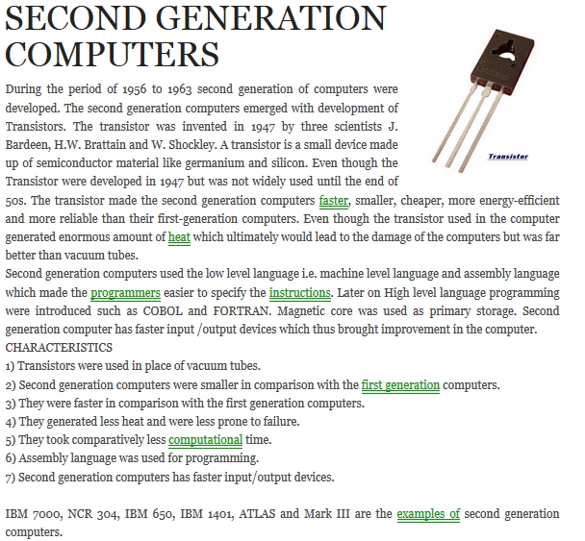

Slide 20
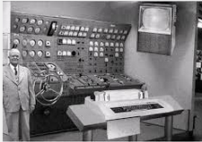
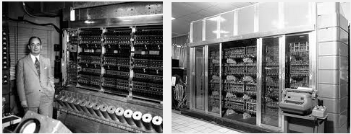

Slide 21
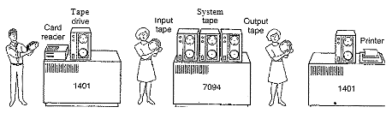

Slide 22
Third Generation (1964-1971) Integrated Circuits
The development of the integrated circuit was the hallmark of the third generation of computers. Transistors were minimized and placed on silicon chips, called semiconductors, which drastically increased the speed and efficiency of computers.
Instead of punched cards and printouts, users interacted with third generation computers through keyboards and monitors and interfaced with an operating system, which allowed the device to run many different applications at one time with a central program that monitored the memory. Computers for the first time became accessible to a mass audience because they were smaller and cheaper than their predecessors.

Slide 23
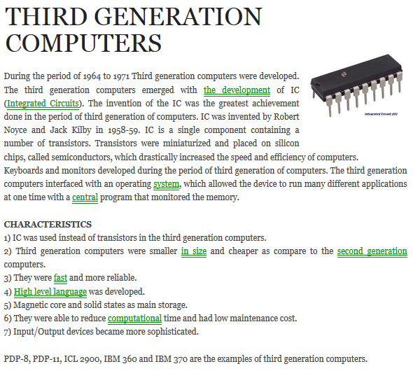

Slide 24
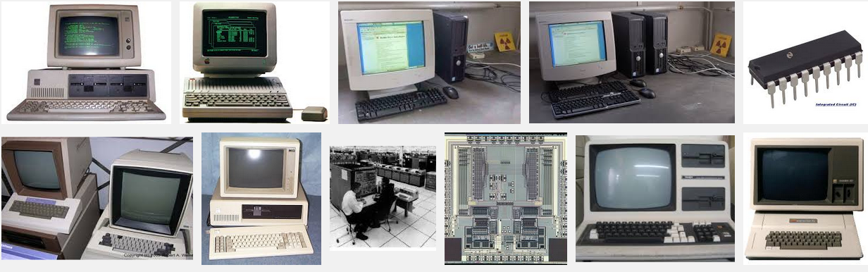
Sample Computers of 3rd Gen

Slide 25
Fourth Generation (1971-Present) Microprocessors
The microprocessor brought the fourth generation of computers, as thousands of integrated circuits were built onto a single silicon chip. What in the first generation filled an entire room could now fit in the palm of the hand. The Intel 4004 chip, developed in 1971, located all the components of the computer from the central processing unit and memory to input/output controls on a single chip.
In 1981 IBM introduced its first computer for the home user, and in 1984 Apple introduced the Macintosh. Microprocessors also moved out of the realm of desktop computers and into many areas of life as more and more everyday products began to use microprocessors.
As these small computers became more powerful, they could be linked together to form networks, which eventually led to the development of the Internet. Fourth generation computers also saw the development of GUIs, the mouse and handheld devices.

Slide 26
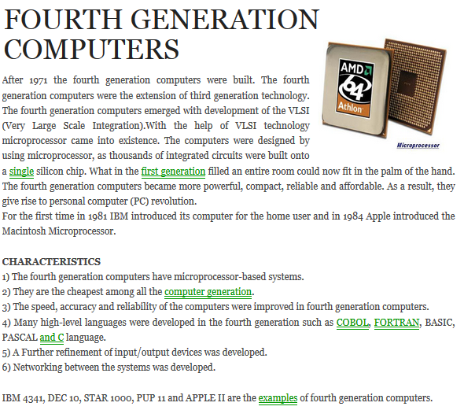

Slide 27
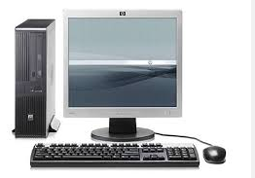
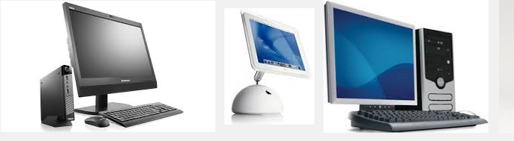
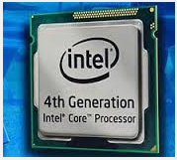
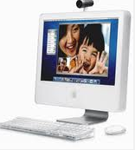
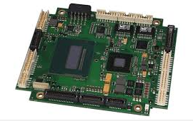
Sample computers of 4th Gen

Slide 28
Fifth Generation (Present and Beyond) Artificial Intelligence
Fifth generation computing devices, based on artificial intelligence, are still in development, though there are some applications, such as voice recognition, that are being used today. The use of parallel processing and superconductors is helping to make artificial intelligence a reality. Quantum computation and molecular and nanotechnology will radically change the face of computers in years to come. The goal of fifth-generation computing is to develop devices that respond to natural language input and are capable of learning and self-organization.

Slide 29
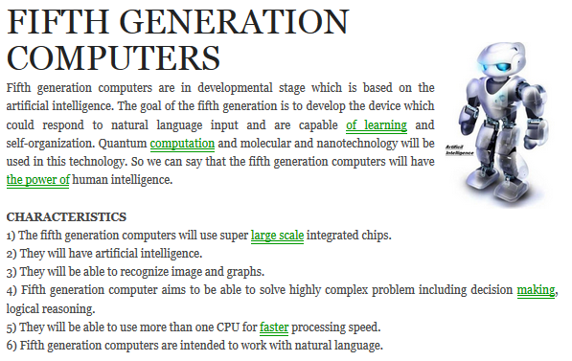

Slide 30
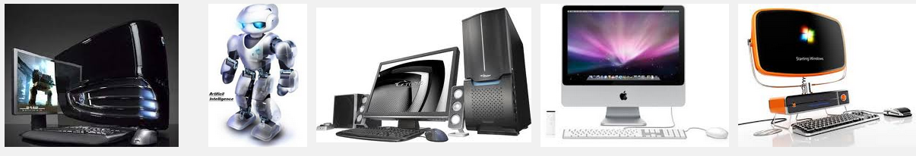
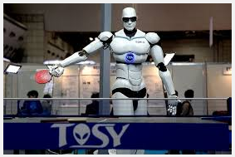
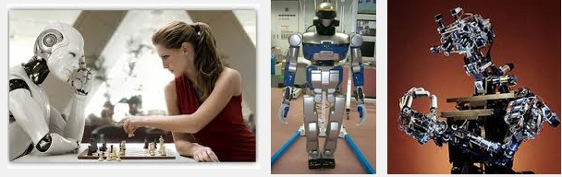
This is not in our chapter …….

Slide 31
Computer Hardware Review
An OS is intimately tied to the hardware of the computer it runs on. It extends the computer’s instruction set and manages its resources. To work, it must know a great deal about the hardware, at least about how the hardware appears to the programmer. For this reason, let us briefly review computer hardware as found in modern personal computers. After that, we can start getting into the details of what OS do and how they work. Some of the components are mentioned below:
CPU – Memory --- Monitor – Keyboard – Printer -- HD

Slide 32
Processors
A processor is the logic circuit that responds to and processes the basic instructions that drive a computer.
The term processor has generally replaced the term central processing unit (CPU). The processor in a personal computer or embedded in small devices is often called a microprocessor.
The “Brain” of the computer is the CPU. It fetches instructions from memory and executes them. The basic cycle of every CPU is to fetch the first instruction from memory, decode, and execute subsequent instructions. The cycle is repeated until the program finishes. In this way, programs are carried out. Each CPU has a specific set of instructions that it can execute.

Slide 33
Memory
The second major component in any computer is the memory. Ideally, a memory should be extremely fast (faster than executing an instruction so the CPU is not held up by the memory) abundantly large and dirt cheap. No current technology satisfies all of these goals, so a different approach is taken. The memory system is constructed as a hierarchy of layers as shown in fig below. The top layers have higher speed, smaller capacity and greater cost per bit than the lower ones, often by factors of a billion or more.

Slide 34
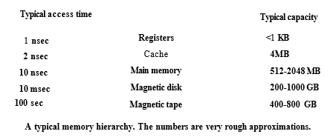
The top layer consists of the registers of internal CPU. They are made of the same material as the CPU and are thus just as fast as the CPU. Consequently, there is no delay in accessing them. The storage capacity available in them is typically 32 x 32 bits on a 32-bit CPU and 64 on 64 bit CPU. Less than 1 KB in both cases.

Slide 35
Every computer has some main memory that it uses to hold executing programs. In a very simple OS, only one program at a time is in memory. To run a second program, the first one has to be removed and the second one placed in memory.
more sophisticated OS allows multiple programs to be in memory at the same time. To keep them from interfering with one another (and with OS), some kind of protection mechanism is needed.

Slide 36
Cache Memory
A collection of items of the same type stored in a hidden or inaccessible place.
An auxiliary memory from which high-speed retrieval is possible.
Youtube, .np, ……. Sort of EX.
Next comes the cache memory, which is mostly controlled by the hardware. Main memory is divided up into cache lines, typically 64 bytes, with addresses 0 to 63 in cache line 0, addresses 64 to 127 in cache line 1 and so on.

Slide 37
Go urself …..
Cache memory, also called CPU memory, is random access memory (RAM) that a computer microprocessor can access more quickly than it can access regular RAM. This memory is typically integrated directly with the CPU chip or placed on a separate chip that has a separate bus interconnect with the CPU.
The basic purpose of cache memory is to store program instructions that are frequently re-referenced by software during operation. Fast access to these instructions increases the overall speed of the software program.
As the microprocessor processes data, it looks first in the cache memory; if it finds the instructions there (from a previous reading of data), it does not have to do a more time-consuming reading of data from larger memory or other data storage devices.
Most programs use very few resources once they have been opened and operated for a time, mainly because frequently re-referenced instructions tend to be cached. This explains why measurements of system performance in computers with slower processors but larger caches tend to be faster than measurements of system performance in computers with faster processors but more limited cache space.
Multi-tier or multilevel caching has become popular in server and desktop architectures, with different levels providing greater efficiency through managed tiering. Simply put, the less frequently access is made to certain data or instructions, the lower down the cache level the data or instructions are written.

Slide 38
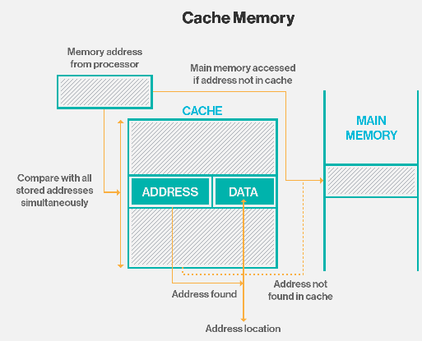
Sample Example

Slide 39
Next: Operating System Concept
Real-Time & Time Sharing
Mainframe Operating System
Personal Computer (PC) OS
Introduction to System Calls
The Shell

Slide 40
Real Time and Time shared
Both time sharing and real time operating system are used for the effective utilization of resources such that it reduces the spare time of CPU but both of them allows the users to work on the some CPU at same time using time slot which provides equal time intervals for various process for their execution. But, still both of them are different from each other which is explained below as follows-

Slide 41
In time sharing operating system, equal time slots are provided to processor for execution of programs which also leads to the context switching, in which process shifts control from one to another. In case any process does not complete its working within time slot then extra time slot will not be given to it. For example- you are running a process with a time slot of 5 seconds and in case process does not complete in 5 second and requires 1 extra second then it will be executed in next execution cycle but time slot will not be extended. (This is Simple to understand). The real time sharing operating system is used in which different processes are executed for some time slot but in some process execution, time slot can be extended for process execution but context switching can also take place in same manner. For example- in case you are executing a process which requires 7 seconds for its completion but process requires 8 seconds then 1 second time period will be extended and after that another time switching take place.

Slide 42
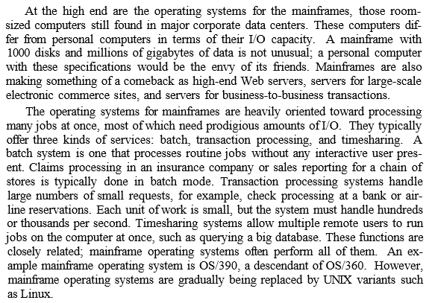
Mainframe Operating System

Slide 43
Personal Computer OS
The next category is the personal Computer OS. Modem ones all support multiprogramming, often with dozens of programs started up at boot time. Their job is to provide good support to a single user. They are widely used for word processing, spreadsheets and internet access. Common ex are Linux, windows vista and Macintosh OS. Personal OS are so widely known that probably little introduction is needed. In fact, many people are not even aware that other kinds exists.

Slide 44
Introduction to System Call
System calls: The mechanism used by an application program to request service from the operating system. System calls often use a special machine code instruction which causes the processor to change mode (e.g. to "supervisor mode" or "protected mode"). This allows the OS to perform restricted actions such as accessing hardware devices or the memory management unit.
Confused Haamm ………..???

Slide 45
System Calls
When a computer is turned on, the program that gets executed first is called the ``operating system.'' It controls pretty much all activity in the computer. This includes who logs in, how disks are used, how memory is used, how the CPU is used, and how you talk with other computers. The operating system we use is called "Unix". The way that programs talk to the operating system is via ``system calls.''
System calls are expensive. While a procedure call can usually be performed in a few machine instructions, a system call requires the computer to save its state, let the operating system take control of the CPU, have the operating system perform some function, have the operating system save its state, and then have the operating system give control of the CPU back to you. This concept is important.
System calls are system dependent. Knowing this, it would not be a good idea to directly use system calls when portability cannot be neglected. System calls are also quite complex. To implement system call, one would need specialized knowledge of I/O registers, the sequence of operations needed to use them; and most important of all, implement enough protection because I/O resources are generally shared among multiple users and/or processes.

Slide 46
Basically System Call is ….
OS manages HW, I/O, Memory File system and so on…
We use this to solve our problem regarding call system.
System call are the function to call the APIs to interact directly with HW.
They keep HW protected.
Most common APIs are which help to call are: Win32 API for Windows, Java API for JVM and POSIX Apis.

Slide 47
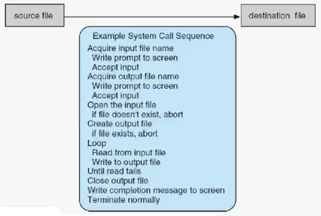
System call sequence to copy the contents of one file to another.

Slide 48
Let me make you simple ….
Let’s Watch this video

Slide 49
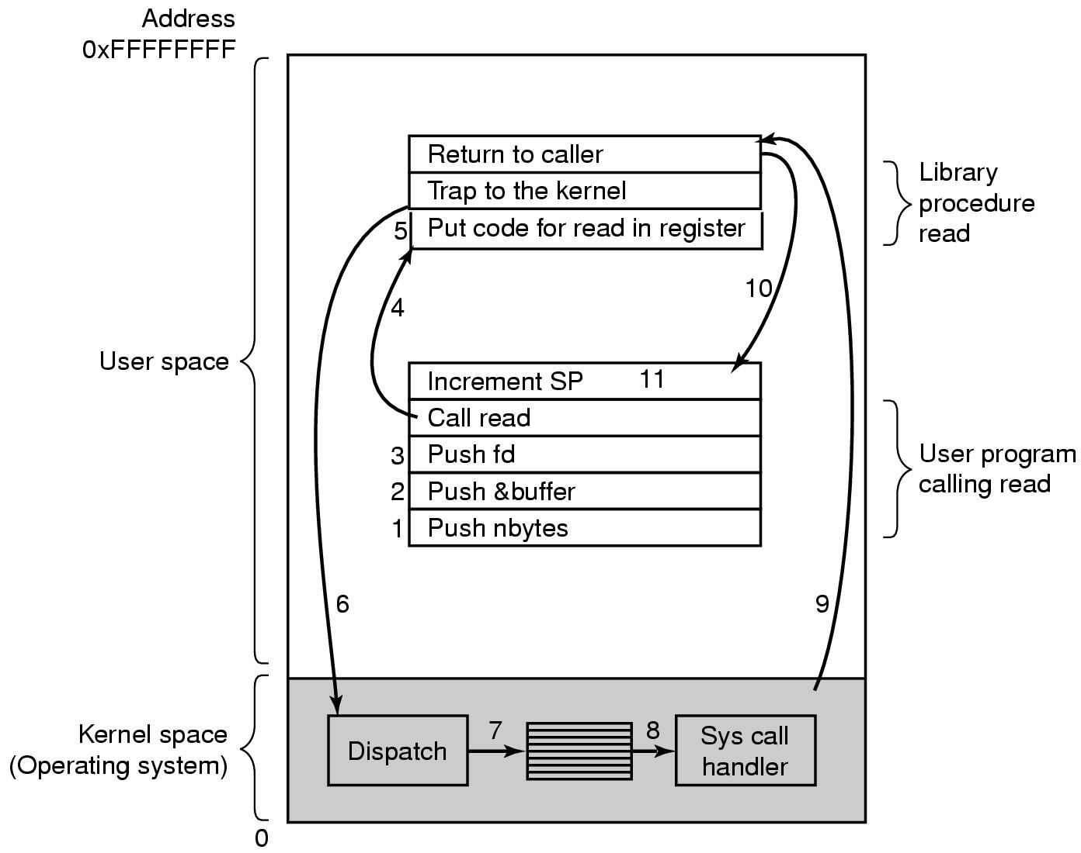
Steps in making a system call

Slide 50
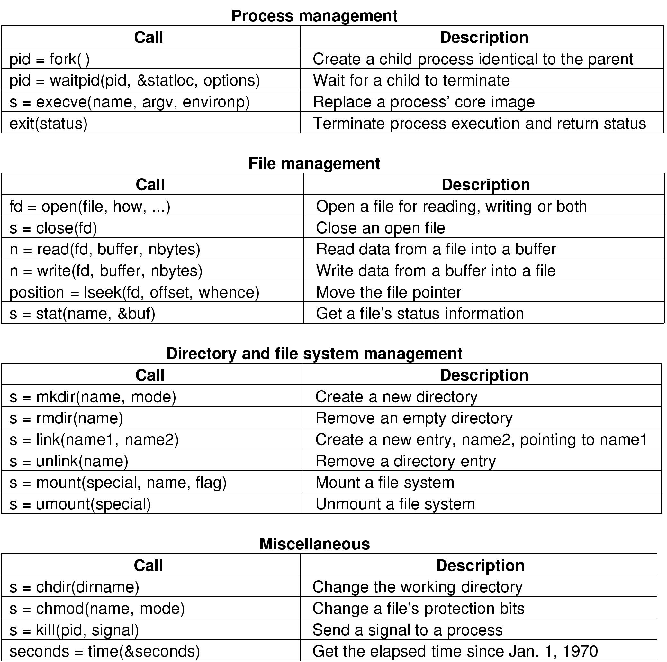
System call for process management

Slide 51
System call for file management

Slide 52
System call for Directory management

Slide 53
System call for Miscellaneous Task

Slide 54
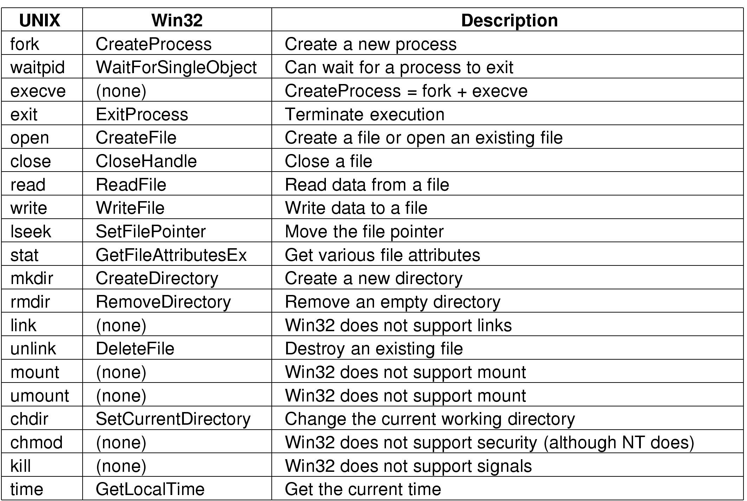
Difference between UNIX and Windows system call

Slide 55
The shell – Command Interpreter
In computing, a shell is a user interface for access to an operating system's services. In general, operating system shells use either a command-line interface (CLI) or graphical user interface (GUI), depending on a computer's role and particular operation.
The outermost layer of a program. Shell is another term for user interface. Operating systems and applications sometimes provide an alternative shell to make interaction with the program easier. For example, if the application is usually command driven, the shell might be a menu-driven system that translates the user's selections into the appropriate commands.

Slide 56
Some more - The shell
Sometimes called command shell, a shell is the command processor interface. The command processor is the program that executes operating system commands. The shell, therefore, is the part of the command processor that accepts commands. After verifying that the commands are valid, the shell sends them to another part of the command processor to be executed.

Slide 57
Tomorrow- Operating System Structure
Monolithic Systems
Layered Systems
Virtual Machine
Client-Server Model

Slide 58
Monolithic Systems
The OS is written as a collection of procedures, linked together into a single large executable binary program. When this technique is used, each procedure in the system is free to call any other one, if the latter provides some useful computation that the former needs. Having thousand of procedures that can call each other without restriction often leads to an unwieldy and difficult to understand system.

Slide 59
Monolithic System …. Easy One
A monolithic kernel is an operating system architecture where the entire operating system is working in kernel space and is alone in supervisor mode. The monolithic model differs from other operating system architectures (such as the microkernel architecture) in that it alone defines a high-level virtual interface over computer hardware. A set of primitives or system calls implement all operating system services such as process management, concurrency, and memory management. Device drivers can be added to the kernel as modules.

Slide 60
To construct the actual object program of the OS when this approach is used, one first compiles all the individual procedures and then binds them all together into a single executable file using the system linker. In terms of information hiding, there is essentially none – every procedure is visible to every other procedure. (as opposed to a structure containing modules or packages, in which much of the information is hidden away inside modules, and only the officially designated entry points can be called from outside the module).

Slide 61
Even in monolithic system, however, it is possible to have some structure. The services (system calls) provided by the OS are requested by putting the parameters in a well-defined place (e.g., on the stack) and then executing a trap instruction. This instruction switches the machine from user mode to kernel mode and transfers control to the OS. The OS then fetches the parameters and determines which system call is to be carried out. After that, it indexes into a table that contains in slot and a pointer to the procedure that carries out system call.

Slide 62
This organization suggests a basic structure for the OS: This organization suggests a basic structure for the OS:
1. A main program that invokes the requested service procedure.
2. A set of service procedures that carry out the system calls.
3. A set of utility procedures that help the service procedures.

Slide 63
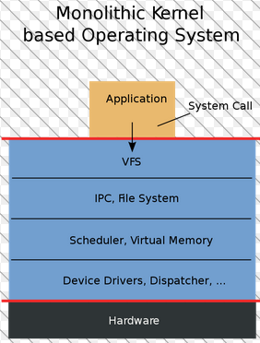
In this model, for each system call there is one service procedure that takes care of it and executes it. The utility procedures do things that are needed by several operator console.

Slide 64
Layered System
Layered Systems use layers to separate different units of functionality. Each layer only communicates with the layer above and the layer below. Each layer uses the layer below to perform its function. Communication happens through predefined, fixed interfaces.
A Layer is a design construct. It is implemented by any number of classes or modules that behave like they are all in the same layer. That means that they only communicate with classes in layers immediately above or below their layer and with themselves.

Slide 65
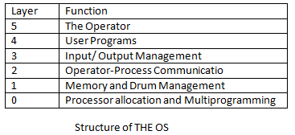
Sample Example of Layered System

Slide 66
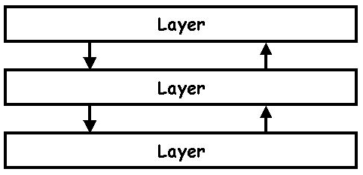
Sample how it works

Slide 67
Where does it come from?
The first use of layers in software architecture is in The structure of the 'THE'-multiprogramming system by E.W. Dijkstra (1968).
When should you use it?
The layered system is ideal when your system has different levels of functionality. The function you want your system to perform is actually performed at the lowest level, or layer. But you do not want to call the functions at the lowest level directly all the time, because they are complex to use, they have several different implementations, etc. At the highest level you just want a few simple functions to do the things you want. Let the lower layers sort the rest out.

Slide 68
How does it work?
Each layer offers its own kind of functionality. Lower layers are usually more domain specific, closer to the machine's hardware. A higher layer uses a its lower layer to perform its function. It requires its lower layer. It is even allowed for a layer to use other layers that are lower or higher than its immediate neighbor, but these should remain exceptions. They are called bridges and should be properly documented.
Each layer contains any number of objects. These objects communicate with other objects in the same layer and in the layers above and below.
Its possible to define multiple layers at the same level. It implies that objects of these layers do not communicate with each other.

Slide 69
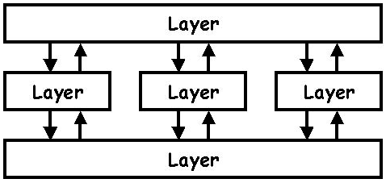
The user calls a function on an object in the upper layer. This object calls functions in the layer below. These functions in turn approach the layer below and the layer above. Etc. Eventually the function is performed and control is returned to the user. All this is usually done sequentially, in the same thread.

Slide 70
Problems
It can be hard to specify and maintain fixed interfaces between the layers.
Layers are sometimes distinguished from Tiers. But the arguments haven't really convinced me. Both layers and tiers make use of their adjacent units. Tiers are often located on different machines, but this is not essential to the architecture.
Common implementation techniques
Layers need no explicit representation. You don't need to create layer classes or the like. Just make sure the objects you create only talk to objects in the correct layers. It's a good idea to use the name of the layer in the classes or modules that belong to it.

Slide 71
Virtual Machine
A virtual machine (VM) is an operating system OS or application environment that is installed on software which imitates dedicated hardware. The end user has the same experience on a virtual machine as they would have on dedicated hardware. In computing, a virtual machine (VM) is an emulation of a particular computer system. Virtual machines operate based on the computer architecture and functions of a real or hypothetical computer, and their implementations may involve specialized hardware, software, or a combination of both.

Slide 72
Specialized software called a hypervisor emulates the PC client or server's CPU, memory, hard disk, network and other hardware resources completely, enabling virtual machines to share the resources. The hypervisor can emulate multiple virtual hardware platforms that are isolated from each other, allowing virtual machines to run Linux and Windows server operating systems on the same underlying physical host. Virtualization saves costs by reducing the need for physical hardware systems. Virtual machines more efficiently use hardware, which lowers the quantities of hardware and associated maintenance costs, and reduces power and cooling demand. They also ease management because virtual hardware does not fail. Administrators can take advantage of virtual environments to simplify backups, disaster recovery, new deployments and basic system administration tasks.
Virtual machines do not require specialized hypervisor-specific hardware. Virtualization does however require more bandwidth, storage and processing capacity than a traditional server or desktop if the physical hardware is going to host multiple running virtual machines. VMs can easily move, be copied and reassigned between host servers to optimize hardware resource utilization. Because VMs on a physical host can consume unequal resource quantities (one may hog the available physical storage while another stores little), IT professionals must balance VMs with available resources.

Slide 73
A virtual machine is a software computer that, like a physical computer, runs an operating system and applications. The virtual machine is comprised of a set of specification and configuration files and is backed by the physical resources of a host. Every virtual machine has virtual devices that provide the same functionality as physical hardware and have additional benefits in terms of portability, manageability, and security.
A virtual machine consists of several types of files that you store on a supported storage device. The key files that make up a virtual machine are the configuration file, virtual disk file, NVRAM setting file, and the log file. You configure virtual machine settings through the vSphere Web Client or the vSphere Client. You do not need to touch the key files.

Slide 74
Why Virtual Machine
Run Old Apps
Access Virus-Infected Data
Browse in complete safely
Test Software, Upgrades or New Configurations
Run Linux on Top of Windows (Or Vice-Versa)
Back Up an Entire OS
Create a Personal Cloud Computer
Make a backup of server for Emergencies
Reuse Old HD

Slide 75
Client-Server Model
The client–server model of computing is a distributed application structure that partitions tasks or workloads between the providers of a resource or service, called servers, and service requesters, called clients.
Often clients and servers communicate over a computer network on separate hardware, but both client and server may reside in the same system. A server host runs one or more server programs which share their resources with clients. A client does not share any of its resources, but requests a server's content or service function. Clients therefore initiate communication sessions with servers which await incoming requests.
Examples of computer applications that use the client–server model are Email, network printing, and the World Wide Web.

Slide 76
Whether a computer is a client, a server, or both, is determined by the nature of the application that requires the service functions. For example, a single computer can run web server and file server software at the same time to serve different data to clients making different kinds of requests. Client software can also communicate with server software within the same computer. Communication between servers, such as to synchronize data, is sometimes called inter-server or server-to-server communication.

Slide 77
SUMMARY
Operating systems can be viewed from 2 viewpoints: resource managers and extended machines. In the resource manager view, the OS job is to manage the diff parts of the system efficiently. In the extended machine view, the job of the system is to provide the users with abstractions that are more convenient to use than the actual machine. These include processes, address spaces and files.
OS have a long history, starting from the days when they replaced the operator, to modern multiprogramming systems. Highlights include early batch systems, multiprogramming systems and personal computer systems.

Slide 78
since OS interact closely with the HD, some knowledge of computer HD is useful to understand them. Computers are built up of processors, memories and I/O devices. These parts are connected by buses.
The basic concept on which all OS are built are processes. Memory management, I/O Management, the file system and security. The heart of any OS is the set of system calls that it can handle. These tell what the OS really does. For UNIX, we have looked at 4 group of system calls. The 1st group of system calls relates to process creation and termination. The 2nd group is for reading and writing files. The 3rd group is for directory management. The 4th group contains miscellaneous calls.
The OS can be structured in several ways. The most common ones are as a monolithic system, a hierarchy of layers, microkernel, client-server, virtual machine or exokernel.

Slide 79
Thank you
That’s all for our FIRST UNIT. If you have any problem then Suman Sir is here if no then Have a good time for 1st Assignment.
Best Of Luck …………. ☺

